Slide 1



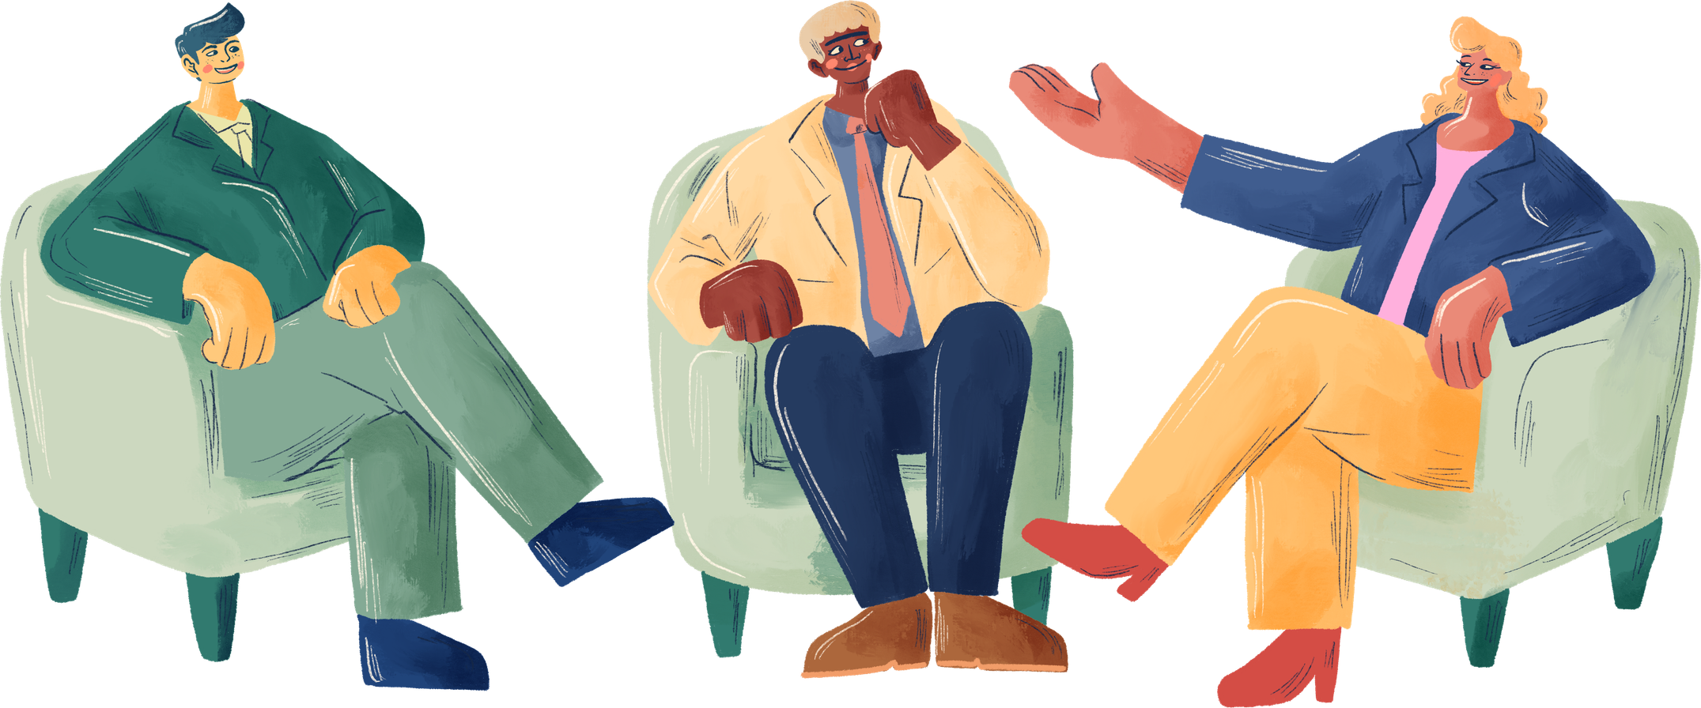




March 2026
Self Esteem & Assertive communication
Prepared by:
T. Chinthu-Banda

Slide 2
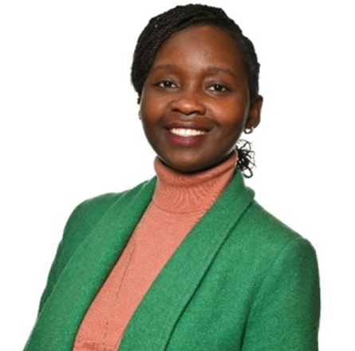






About Myself
Experience in more than 4 Industries
Marketing experience:
T. Chinthu-Banda
B.Sc. in Entrepreneurship and Business management
M.Sc. in International Business
M.Sc. in International Marketing

Slide 3

Servas
Embracing more than 100 countries, Servas provides a network for its members to make contact, to build friendships and to broaden our understanding of the world.
Servas Malawi Youth Rep (Since 2018)
Servas International youth and Families Committee (2023-24)
  South Korea 2018
  Italy 2020
  France 2024
  Italy 2025
Volunteering, presenting about Malawi, organising youth camps, and publishing Newsletters.

Slide 4

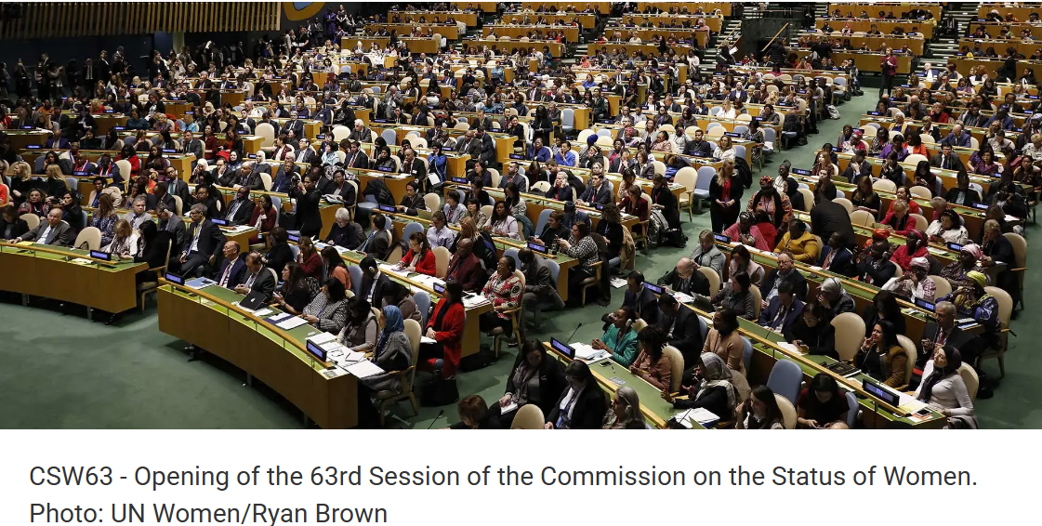
Servas
Advocate for Peace
Share about Servas
Showcase member activities

Slide 5


What are we
talking about ?
Affirmative communication
Non Violent Communication
Setting healthy social and professional boundaries.
Assertiveness

Slide 6

Assertiveness
Internal capacity to standup for yourself
Notes:
Confidence
Self-belief
Willingness to speak up
Emotional regulation

Slide 7

Assertiveness
Can you say “no” without excessive guilt?
Do you feel confident making independent decisions?
Are you comfortable believing that your needs are as important as others’?
Are you willing to speak up if something feels wrong or unfair?
Notes:
Overall evaluation of one's own worth or value.
A favorable or unfavorable attitude toward the self.

Slide 8

Assertive communication
The How!
communication style used to express assertiveness.
tone
language
body language
Notes:
Clear “I” statements
Direct but respectful wording
Calm tone of voice
Appropriate eye contact
Specific requests rather than vague complaints
It is a communication technique — not a personality trait.

Slide 9
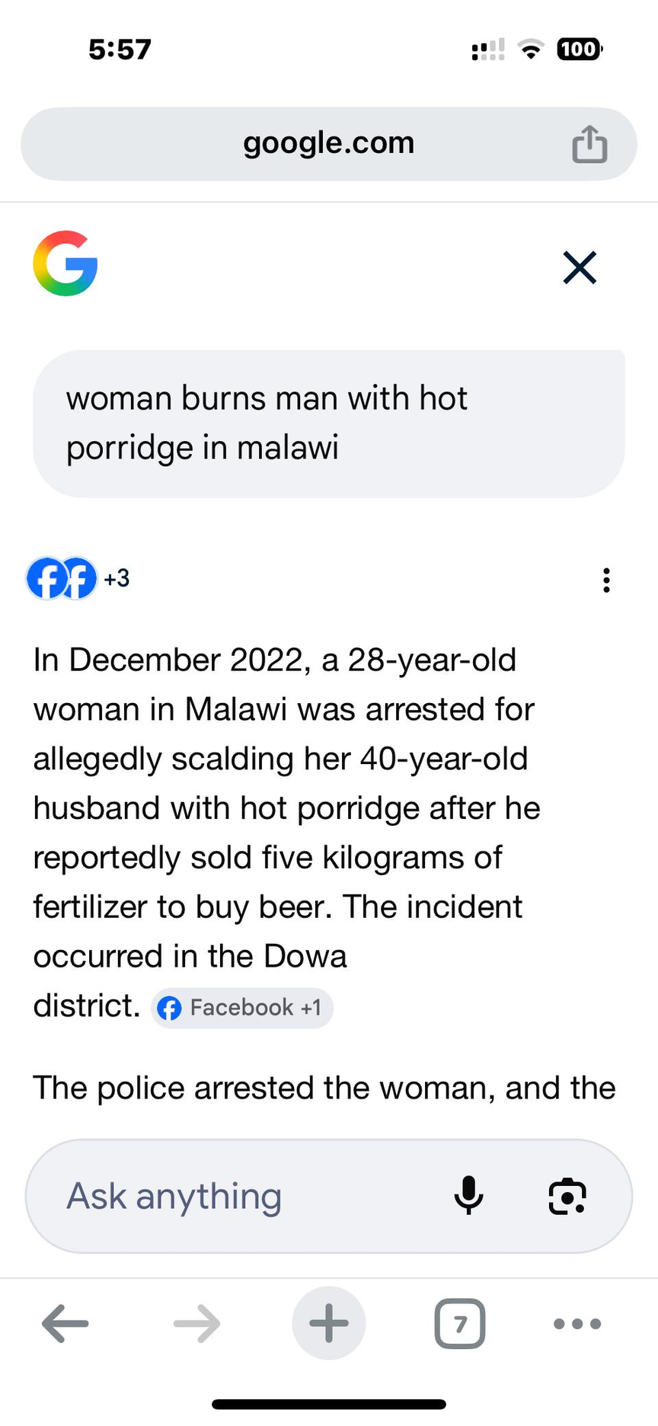
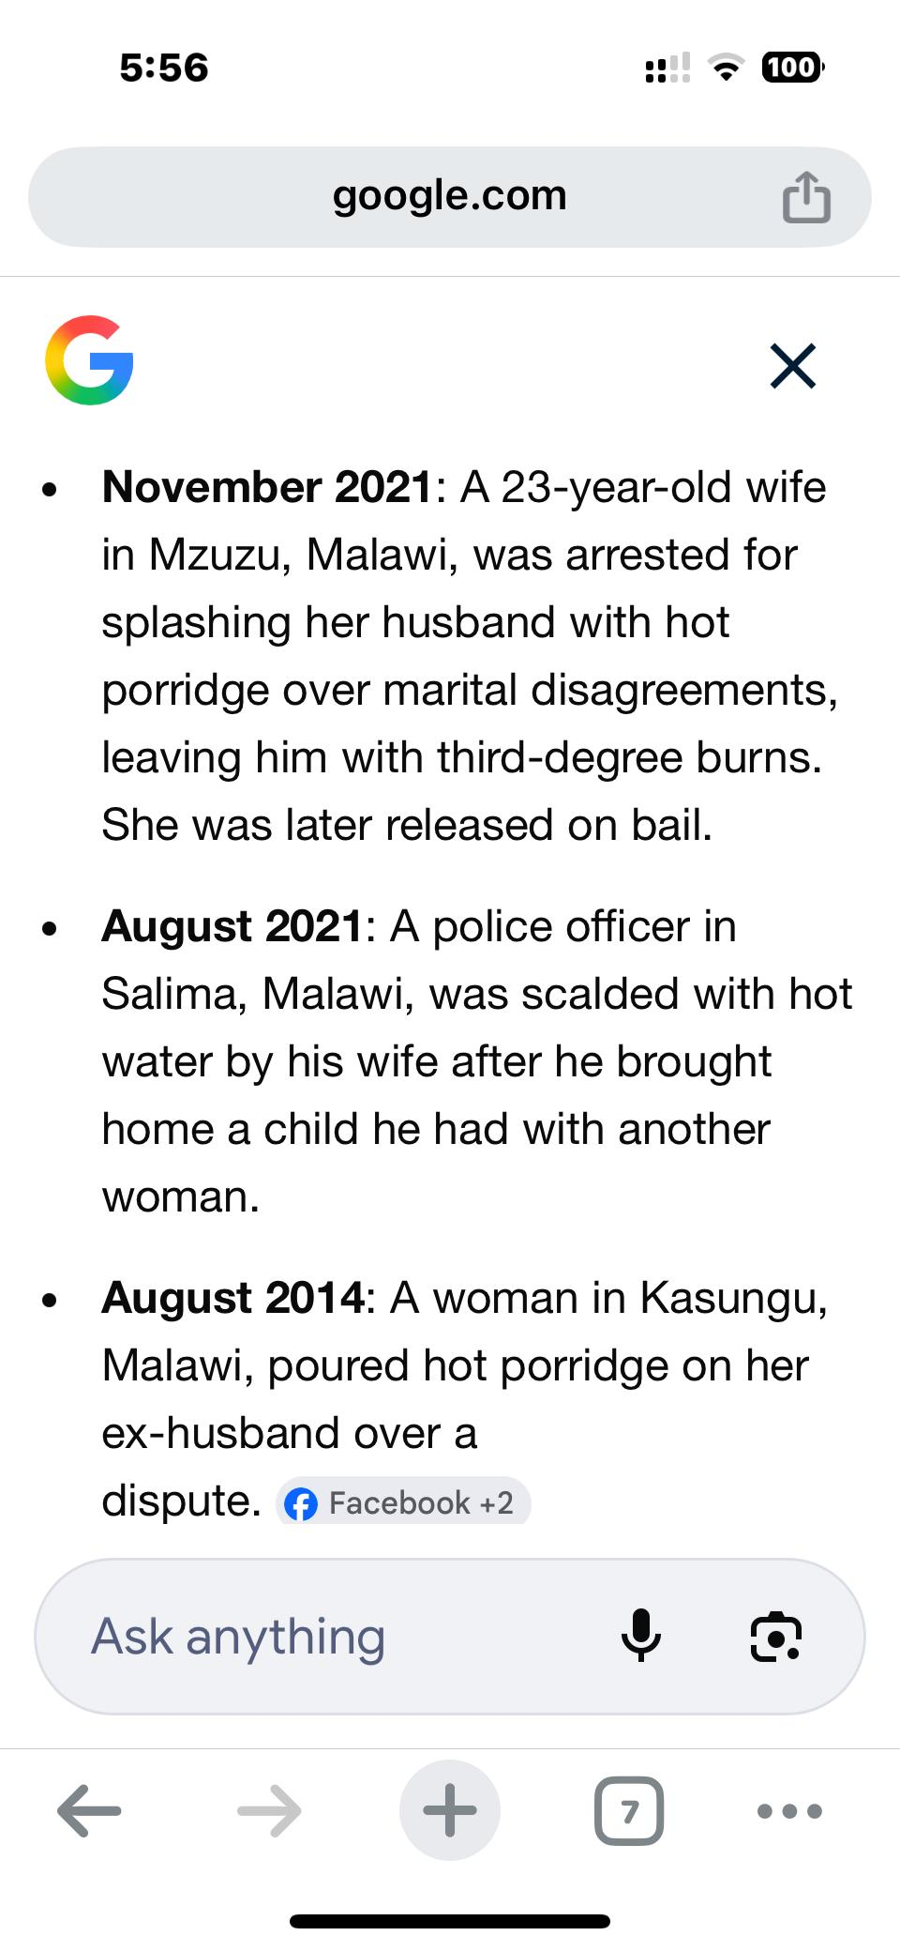
Assertive communication
Notes:
Overall evaluation of one's own worth or value.
A favorable or unfavorable attitude toward the self.

Slide 10
Assertive communication
3-Part Assertive Formula
“When you ___, I feel ___, and I would prefer ___.”
When jokes are made about my goals, I feel discouraged, and I would prefer encouragement or constructive feedback instead.
“Mukakhala ___, Ndi maona ___, Ndi ngakonde ___.”
maganizira ___, zingakhale bwino___.”
Notes:
Clear “I” statements
Direct but respectful wording
Calm tone of voice
Appropriate eye contact
Specific requests rather than vague complaints
It is a communication technique — not a personality trait.

Slide 11

The
Broken Record
Carmly repeating your request without escalating.
“Just stay late this once.”
I understand it’s urgent, but I won’t be able to stay late today.”
“It’s really important.”
I understand it’s urgent, but I won’t be able to stay late today.”
No new Justifications
No anger
No apology overload.

Slide 12
01.
inherently good
02.
capable of making rational choices
Affirmative Communication
03.
motivated to reach their full potential
A method of communication that validates self and others.
Strongly rooted in humanistic psychology
Notes:
by Source: Rogers (1961)
Affirmative communication refers to a communication approach that acknowledges one’s own rights while respecting the dignity and perspectives of others.

Slide 13
Strategies for
Affirmative Communication
Use “I” Statements
Acknowledge Others Before Responding
Communication barriers.
I feel ___ when ___ because ___.
Active Listening
Be Clear and Direct
Maintain Respectful Tone and Body Language
Express Needs and Requests Clearly
Time management issues.
Balance Self-Respect and Respect for Others

Slide 14


Affirmative Communication
Active listening
-Empathy
-Respect
+
NVC(Non Violent communication)
Paraphrasing what was said
Maintaining eye contact
Avoiding interruption

Slide 15

Nonviolent Communication (NVC)
Structured empathetic communication model
Observation
Feelings
What actually happened?
your emotional response
Needs
The Underlying value
Requests
What would you like happen?
Notes:
1. Observation means describing the situation factually without judgment, interpretation, or criticism.
The goal is to separate facts from evaluations.
Example
Judgment:
“You are always late.”
Observation:
“You arrived 20 minutes after the meeting started.”
Feelings should not contain hidden blame.
Example of blame disguised as feeling:
2. After stating the observation, you express your emotional response to the situation.
This focuses on personal emotions rather than accusations.
“I feel ignored.”
Better:
“I feel frustrated and discouraged.”
3. Needs
In NVC, feelings come from unmet or fulfilled needs, not from other people’s behavior alone.
4. Request (What you would like to happen)
The final step is making a clear, actionable request that could help meet the need.
A good request should be:
specific
realistic
positively stated

Slide 16

Setting Healthy Social-Professional Boundaries
Recognizing Your Limits
Requires assertive and respectful communication
Consistent re-enforcement of your boundaries.
Ones ability to define and successfully communicate their own acceptable and unacceptable behavior in a relationship, to protect one’s well-being, time, and dignity.

Slide 17
Conceptual development Flow
•Self-Esteem (Foundation)
. Assertiveness (Behavioral Expression)
. Affirmative Communication (Relational Style)
.Nonviolent Communication (Structured Empathy)
.Healthy Boundaries (Applied Outcome)

Slide 18
Questions

