Slide 1



Be the best version of yourself
BUILDING YOUR SELF-ESTEEM IN ALL SEASONS
Presented By :
Mercy Mkandawire and Georgina Kanyanda

Slide 2


WHAT IS IMIND?
  Founded in 2017 by Mercy Mkandawire.
  Vision: A generation that values mental well-being as much as physical health.
  Mission: To increase access to youth-friendly mental health and well-being services in Malawi and across Southern Africa through evidence-based research, awareness, and integrated peer, community, and professional support.

Slide 3

WHAT IS SELF-ESTEEM?
Self-esteem is the subjective, overall evaluation of your personal worth, value, and competence/how you perceive yourself.

Slide 4
FACTORS AFFECTING SELF-ESTEEM
self awareness
Confidence
The ability to monitor and understand your own thoughts, emotions, behaviors, and motivations, along with recognizing how these factors impact yourself and others.
The belief in oneself and one's abilities to handle tasks, challenges, and situations effectively.It involves a positive, realistic, and trusting attitude towards your skills, and the willingness to act even in the face of potential failure.
Self Efficacy
The personal belief in one's capability to organize and execute the actions required to manage prospective situations and achieve specific goals.
Self Love
A state of appreciation, high regard, and compassion for oneself that develops from actions supporting physical, psychological, and spiritual growth.

Slide 5
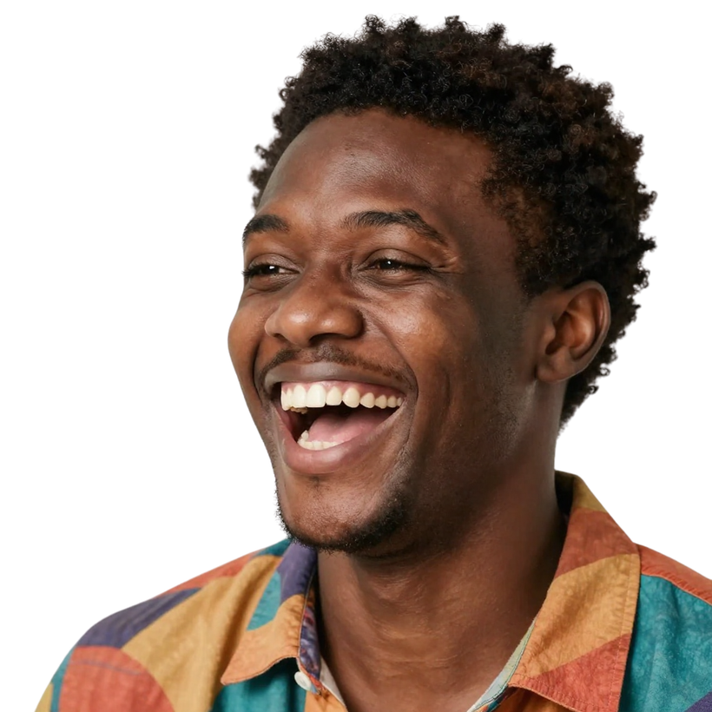
WHAT ARE THE BENEFITS OF HIGH SELF ESTEEM
improved quality of life
More positive attitude towards challenges
A higher success rate (work, school, relationships)
Better mental and physical health.
Agility & Adaptability

Slide 6
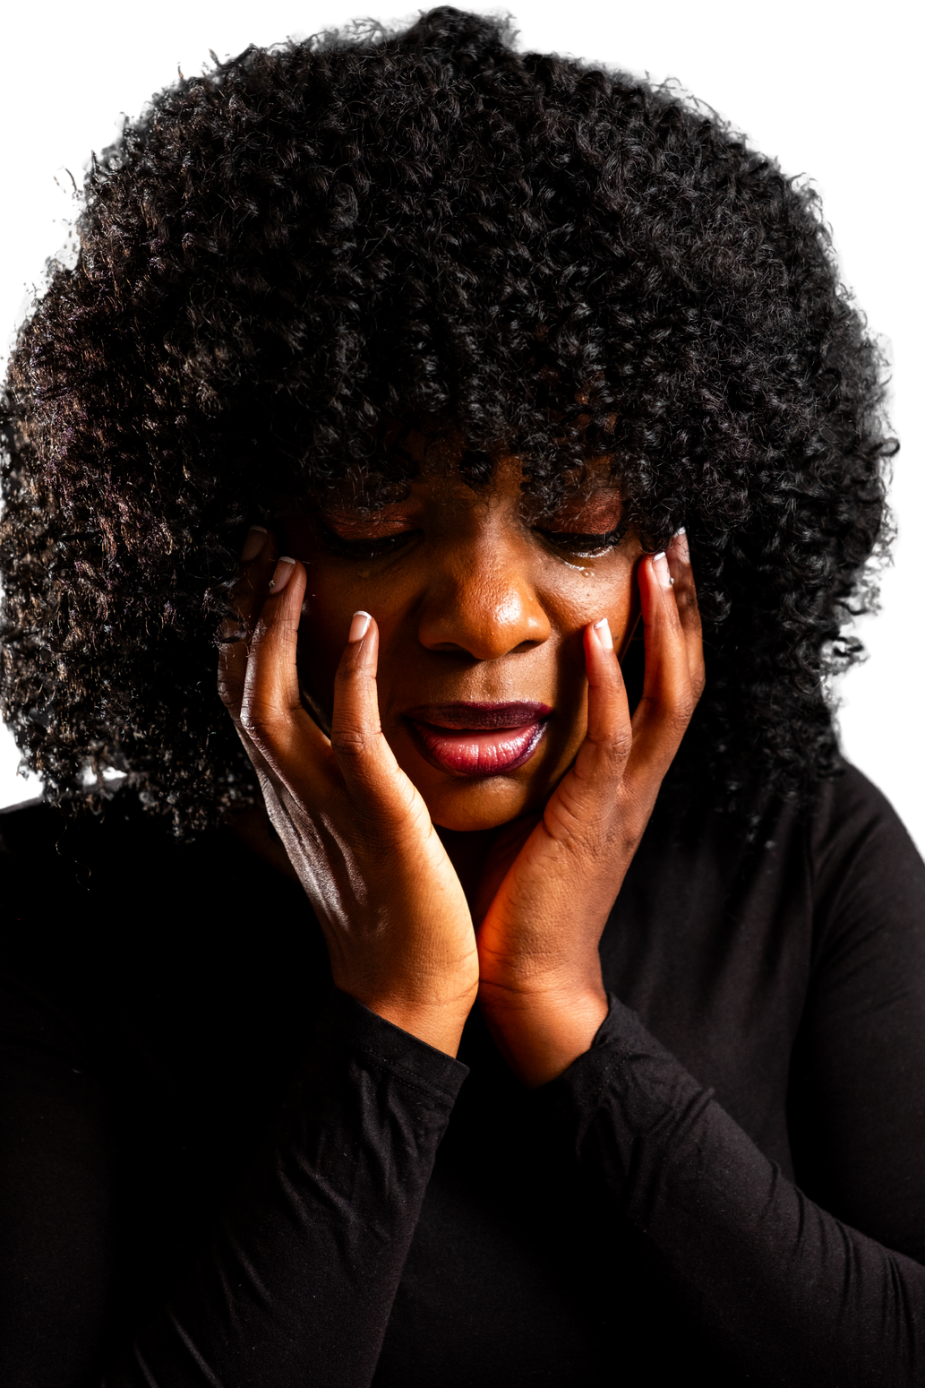
WHAT ARE THE PROBLEMS WITH LOW SELF-ESTEEM
Self doubt
Low success rate
People take advantage of you
People pleasing at your own expense
Low quality of life (what’s the point in trying?)

Slide 7

STRATEGIES TO BUILD YOURSELF UP
Gaal setting
Creating long-term and short-term goals
Principles
what kind of person am i and how do i want to be treated?
Healing
Healing from trauma or events that affected your self eteem.
Communication
Relaying your feelings and being true to yourself
Mindfulness
Using tools such as affirmations and meditation
Being Unapologetically yourelf.

Slide 8
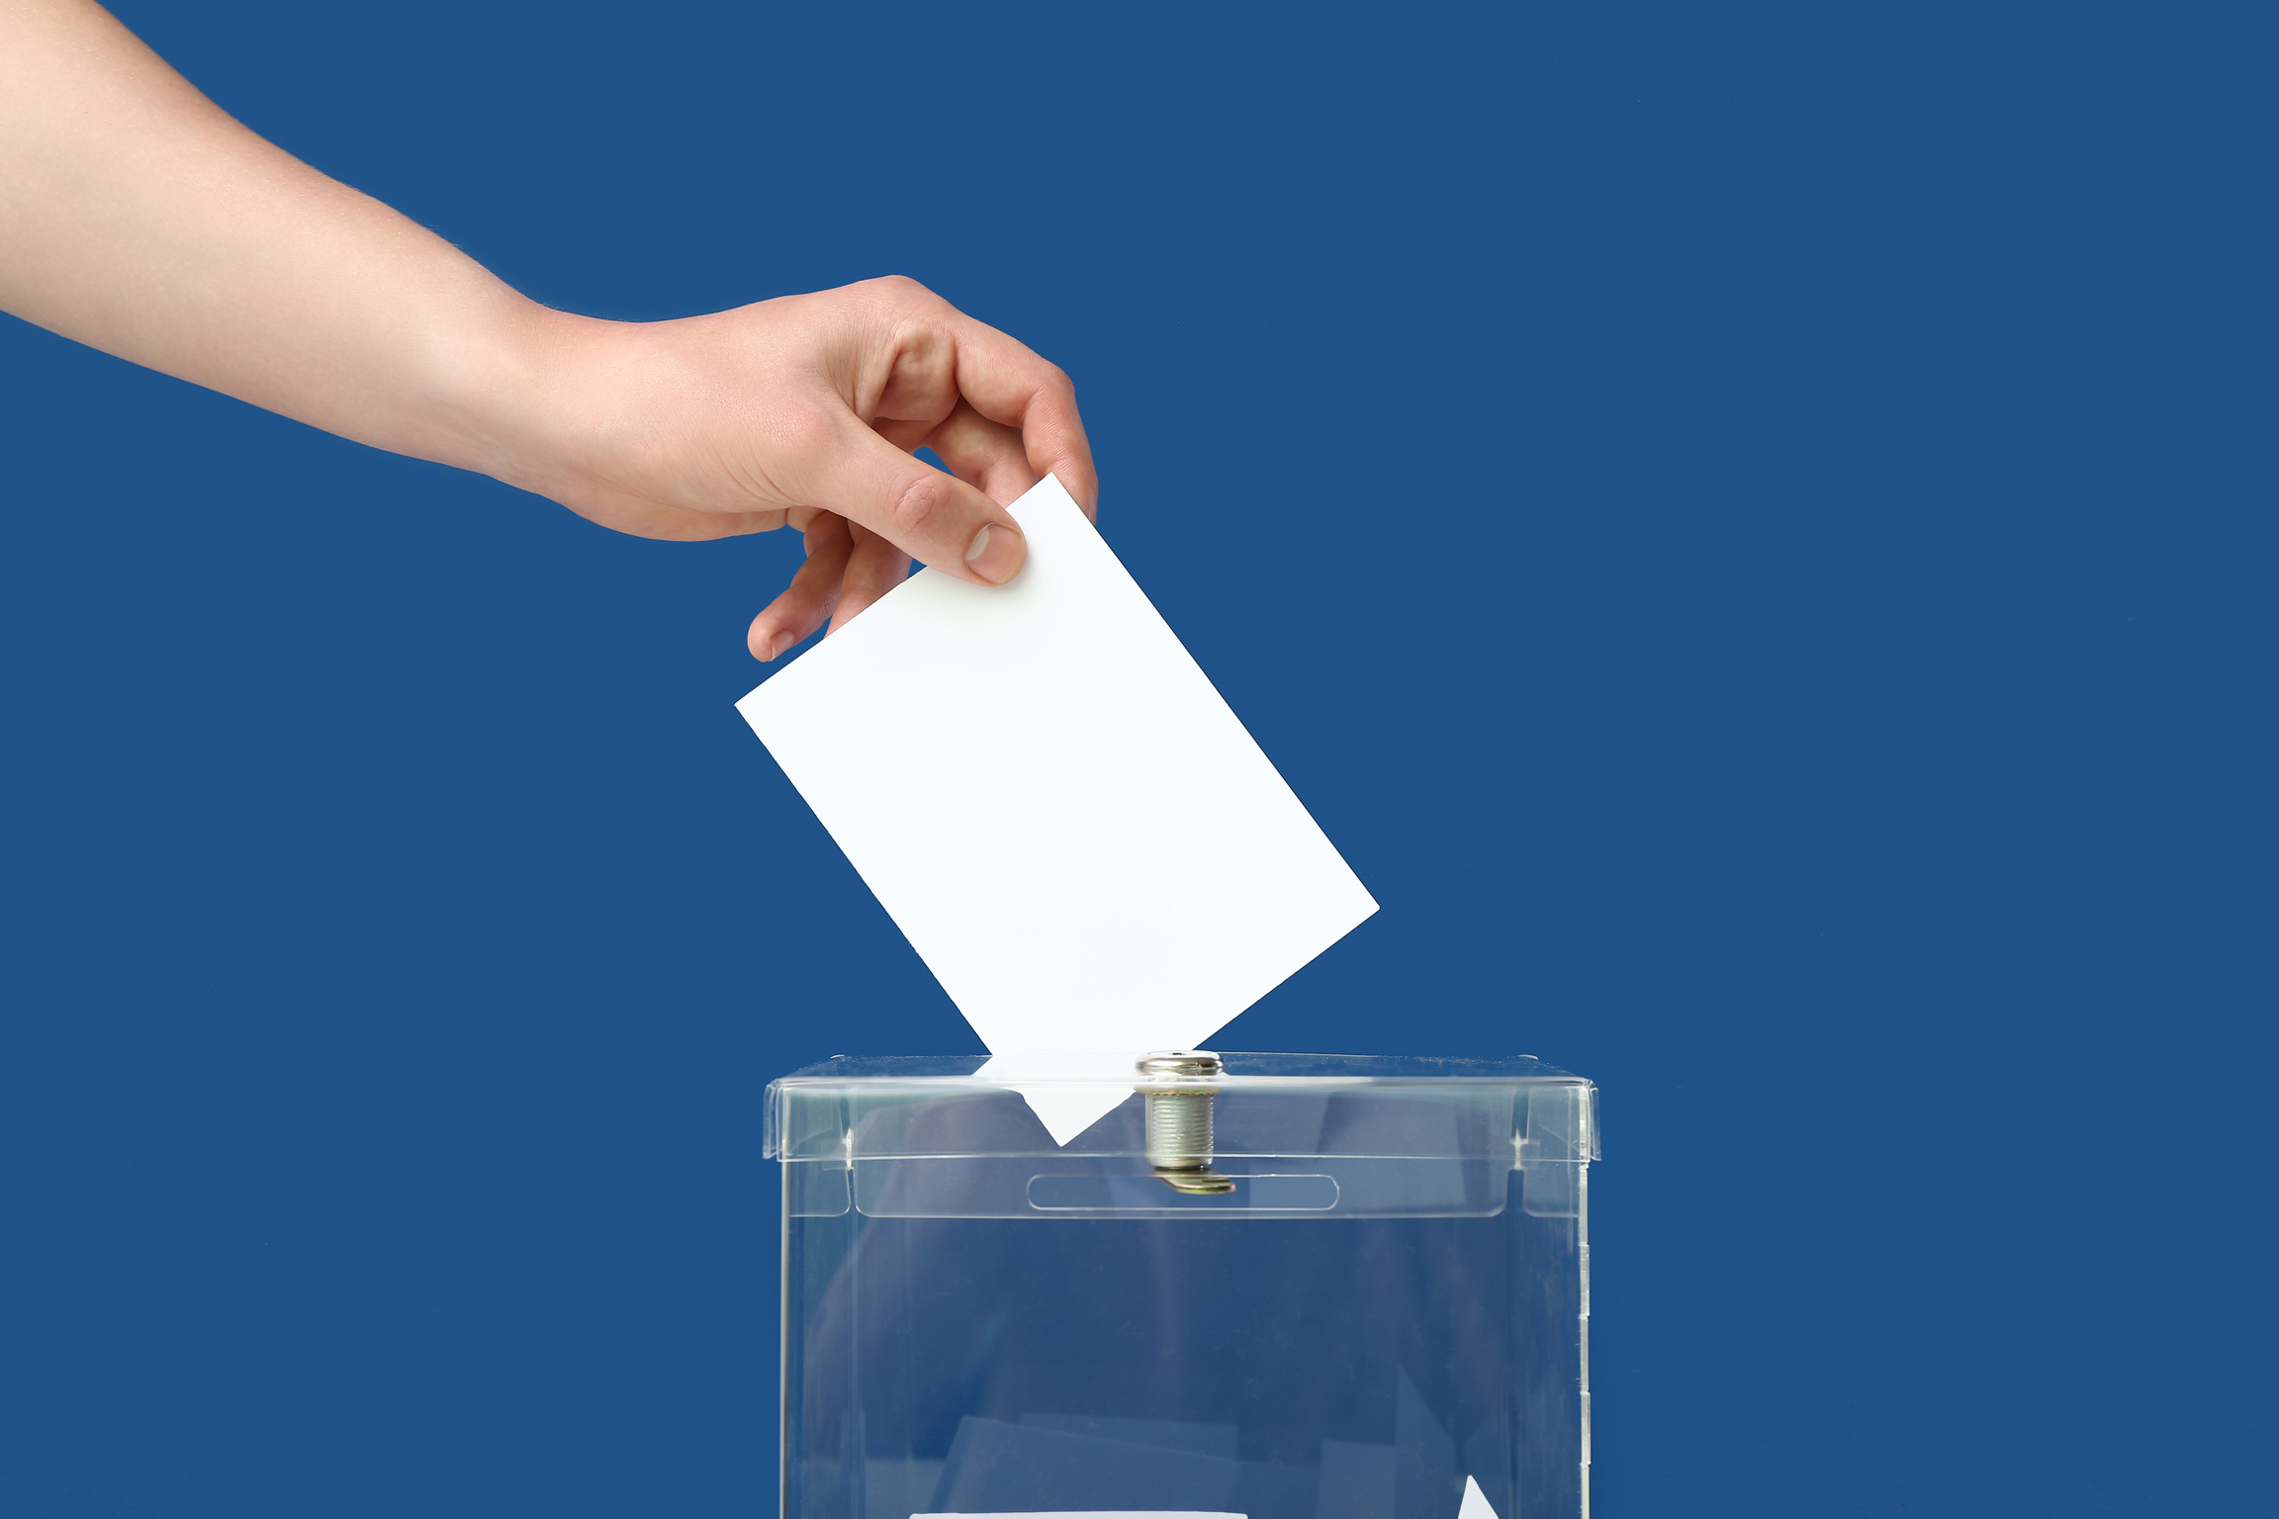
SECRET BALLOT
Question of the day: Write about any events that may have affected or can affect self-esteem.
  Write the answer or any questions that come to mind in regards to self-esteem.
  Fully anonymous so do not write your name.
  Questions will be brought out during discussion time.

Slide 9

“EVERY EMOTIONAL CUT BEARS CREATIVE FRUITS”

Slide 10
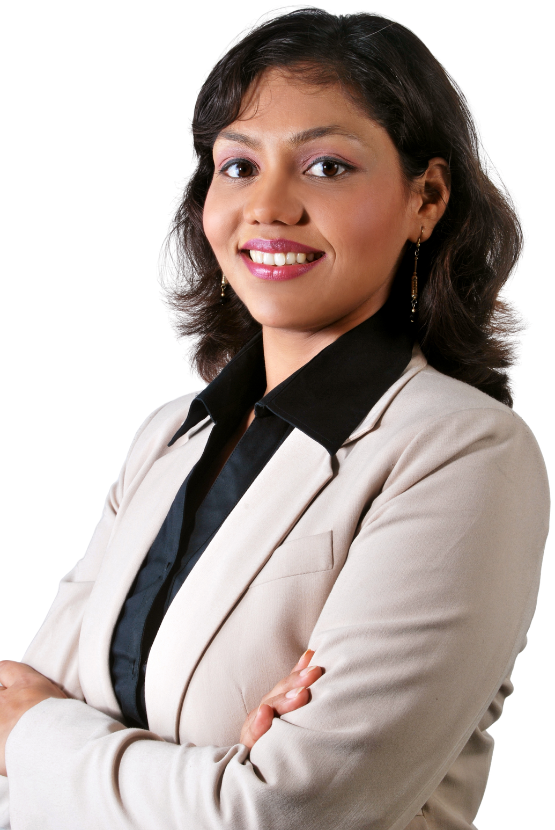
HEALING FROM TRAUMA WORKS HAND IN HAND WITH SELF-ESTEEM
When someone strips you of your power, you need to be able to take it back.
  Forgiving the self and others.
  Choosing to rise above your past.
  Taking strength from experience.
  Learning to fight for yourself and others.
  Learning to defend yourself when needed.

Slide 11
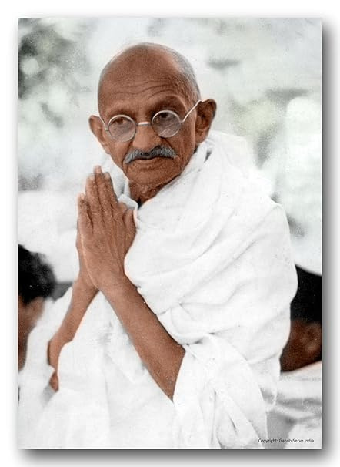
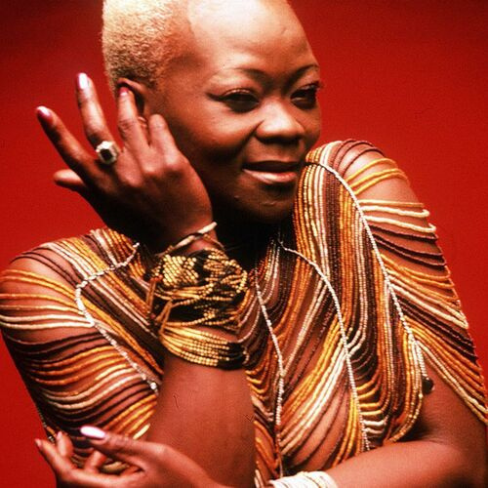
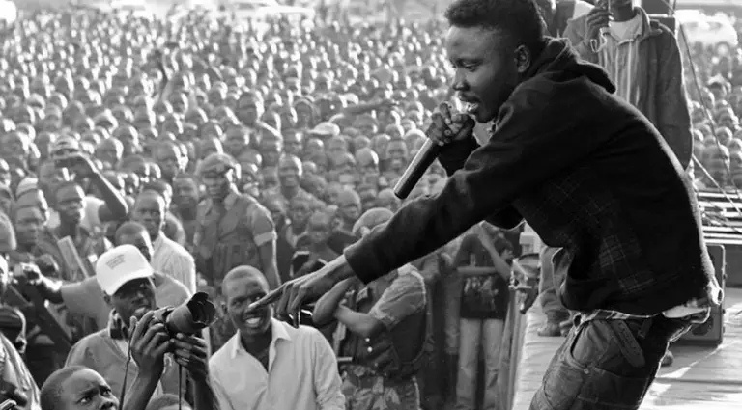
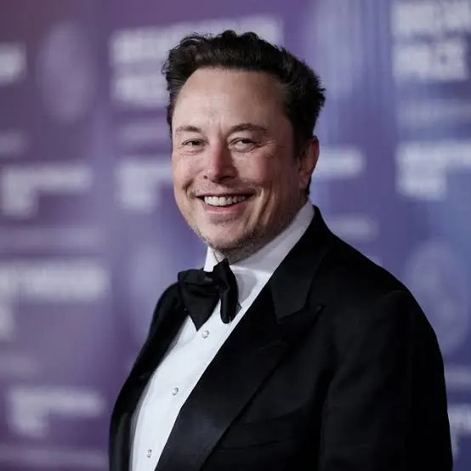
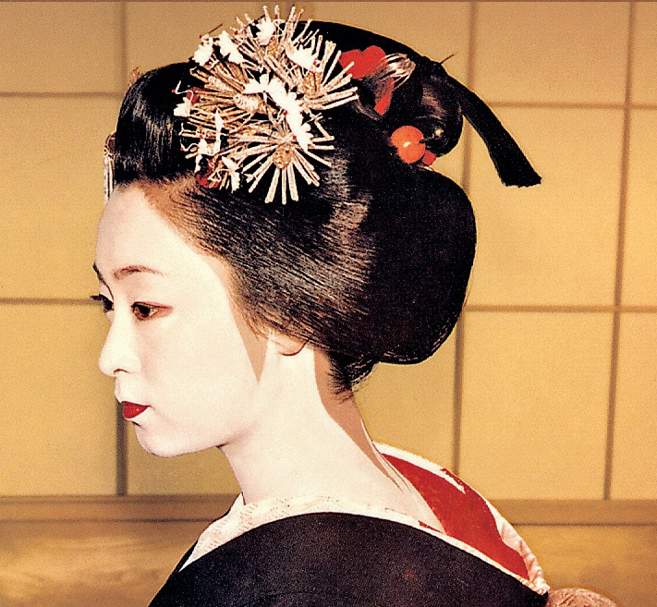
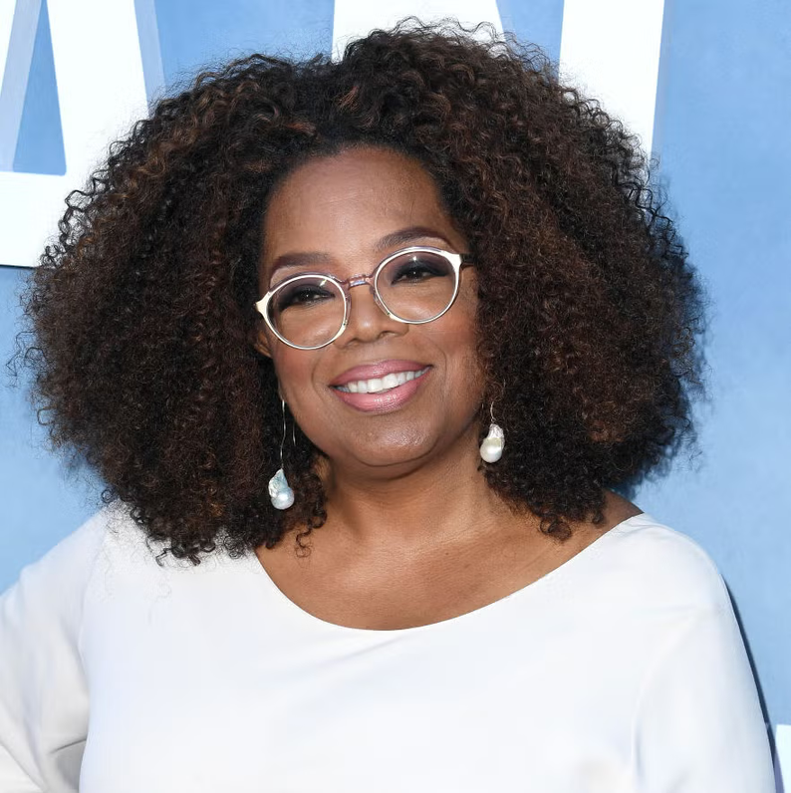
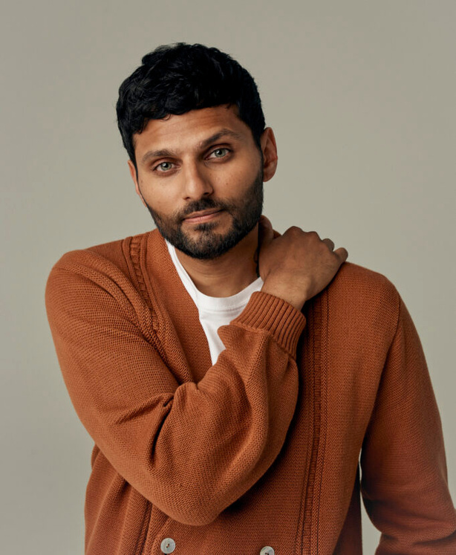
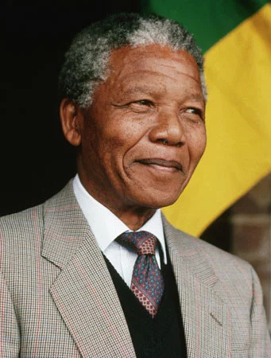
Mahatma Gandhi
Elon Musk
Mafunyeta
Brenda Fassie
Nelson Mandela
Jay Shetty
Mineko Iwasaki
Oprah

Slide 12
HELPLINES AND RESOURCES
On campus;
  Office of the Director of Student Affairs
  MUBAS Clinic
  Students Representative Council (Director of Gender, Ethics and Women Affairs)
  Mr and Miss Mental Health
  GenWell Club
For additional services, reach out to the following;
  iMind: 0993 875 578
  Chipatala chapa foni (MoH): 54747
  GBV Crisis Helpline (YONECO): 5600
  Vintage Health Wellness Center: 0995 260 153
  Georgina Kanyanda (Counsellor): 0888256773
  Queen Elizabeth Central Hospital (Unit 6)
  Your nearest police station

Slide 13
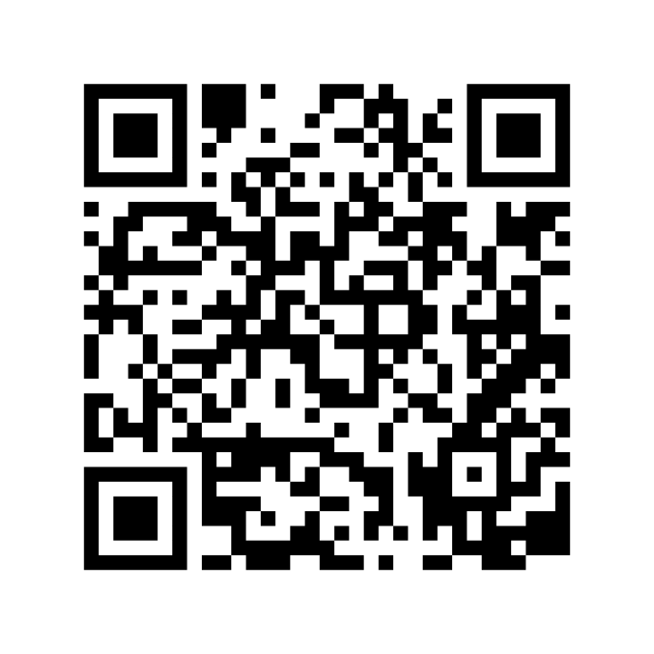
SCAN THE QR CODE TO JOIN THE GENWELL CLUB WHATSAPP FORUM

Slide 14
THANK YOU FOR YOUR ATTENTION
Presented By :
Georgina Kanyanda
Mercy Mkandawire

